Slide 1
Economics 187 Economic Forecasting
Lecture 14
Unit Roots, Stochastic Trends, ARIMA,
Forecasting Models, and Smoothing
Dr. Randall R. Rojas

Slide 2
Today’s Class
Stochastic Trends and Forecasting
Random Walk without Drift
Random Walk with Drift
ARIMA
Unit Roots: Estimation and Testing
Least Squares Regression with Unit Roots
Effects of Unit Roots on the ACF and PACF
Unit Root Tests
R Example

Slide 3



Stochastic Trends and Forecasting
Often in Economics we encounter many nonstationary series (a.k.a. unit-root nonstationary), e.g., interest rates, foreign exchange rates, and the price series of an asset of interest.
Consider an ARMA(p,q) process where one of the p roots of its autoregressive lag operator polynomial is 1 (unit root).
Δy_{t} is covariance stationary.
A nonstationary series is integrated if its
nonstationarity is undone by differencing.

Slide 4
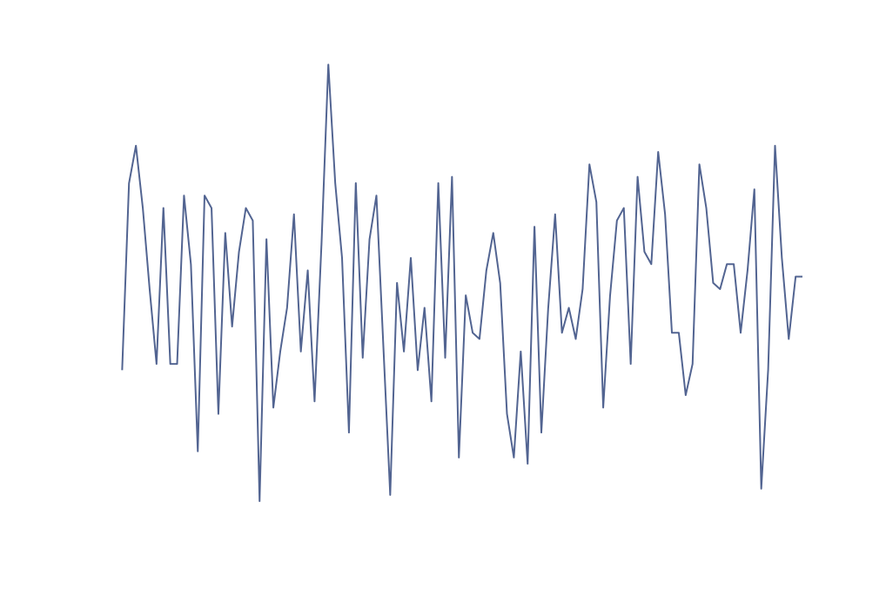
Stochastic Trends and Forecasting -Random Walk 1 of 2
If only one difference is required, the series is said to be integrated of order 1, I(1). In general, for d differences, we have I(d) where the number of differences equals the number of unit roots.
Random Walk: Is an AR(1) process with unit coefficient → y_{t} = y_{t-1} + ε_{t} and ε_{t} ~ WN(0,σ²).
Random walk =
the cumulative sum of
white noise changes.

Slide 5
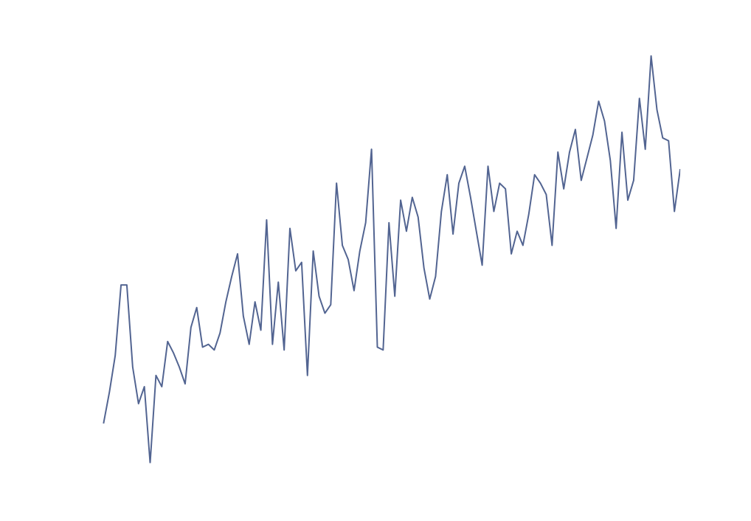
Stochastic Trends and Forecasting -Random Walk 2 of 2
Random Walk with Drift: Is an AR(1) process with unit coefficient → y_{t} =δ + y_{t-1} + ε_{t} and ε_{t} ~ WN(0,σ²).
Stochastic Trend =
Random walk with (or without) drift.

Slide 6



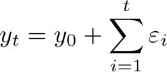

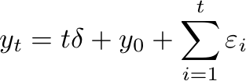
Stochastic Trends and Forecasting -Random Walk 3 of 3
Random walk: Given y_{t} = y_{t-1} + ε_{t} , ε_{t} ~ WN(0,σ²), and y(0) = y₀→
Random Walk with a Drift: Given y_{t} =δ + y_{t-1} + ε_{t} , ε_{t} ~ WN(0,σ²), and y(0)=y₀→

Slide 7
Stochastic Trends and Forecasting -ARIMA(p,1,q)
ARIMA: Autoregressive integrated moving average.
The ARIMA(p,1,q) process is a stationary and invertible ARMA(p,q) process in first differences:
where

Slide 8
Stochastic Trends and Forecasting -ARIMA(p,d,q)
In general, for the ARIMA(p,d,q) model
The ARIMA(p,d,q) process is a stationary and invertible ARMA(p,q) after differencing d times.
where

Slide 9
Unit Roots: Estimation and Testing LS Regression with Unit Roots 1 of 2
We will consider Least Squares (LS) estimators in the case of models with unit roots:
Let y equal a random walk , y_{t} = y_{t-1} + t.
If we did not know that the autoregressive coefficient is 1, we can estimate it via, e.g., AR(1) → y_{t} =φy_{t-1} + t.
Two implications are superconsistency and bias.
Notes:
If we do not know if there is a drift or not, we could do a t test on the coefficients of t and phi

Slide 10

Unit Roots: Estimation and Testing LS Regression with Unit Roots 2 of 2
Superconsistency: For the unit root (φ =1) case, as the sample size T grows, -1 goes to zero very quickly (~1/T) → LS estimator of a unit root is superconsistent (good for forecasting).
For the covariance stationary case, |φ|<1, -1 goes to zero as 1/T^{1/2}.
The LS is biased downward, i.e., E[ ] < φ_{True} →Bias is worst in the unit root case.

Slide 11
Unit Roots: Estimation and Testing Unit Root Tests 1 of 4
Series with unit roots, should be checked for their presence via e.g., a t-statistic for a 0 coefficient and for a unit coefficient.
For the unit root case, follows a Dickey-Fuller Distribution.
For the general, nonzero mean case (under the alternative hypothesis), the process is a covariance stationary AR(1) process in deviations from the mean. → y_{t} =α +φ y_{t-1} + ε_{t} , where α =μ(1-φ).
Note: The Dickey-Fuller statistic table is for (α, φ)=(0,1).

Slide 12
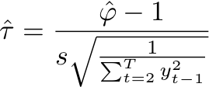
Unit Roots: Estimation and Testing Unit Root Tests 2 of 4
The statistic, can be computed from the t-test by regressing y_{t} on y_{t-1} when testing for φ=1.
We can extend the model to allow for deterministic trend: y_{t} =α +β TIME_{t}+φ y_{t-1} + ε_{t} (for φ=1, this is a random walk with drift), where α =a(1-φ)+bφ and β=b(1-φ).
(Dickey-Fuller Statistic)

Slide 13
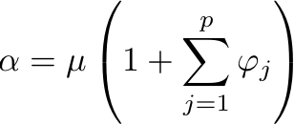
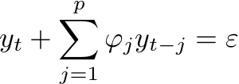
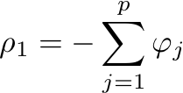
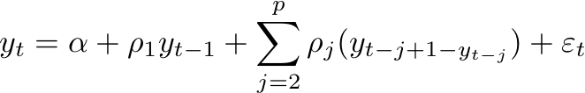
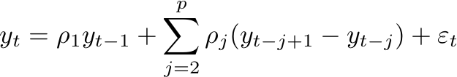
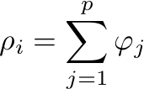
Unit Roots: Estimation and Testing Unit Root Tests 3 of 4
For the general AR(p) process:
where and , i =2,…,p.
For the nonzero mean case:
where .

Slide 14
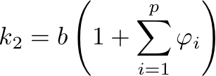
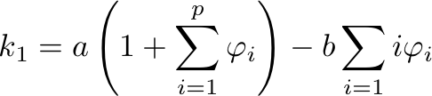
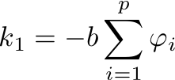
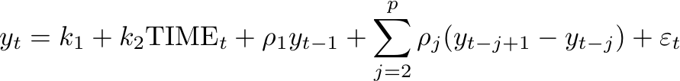
Unit Roots: Estimation and Testing Unit Root Tests 4 of 4
For the general AR(p) process with a linear trend:
where and
under the null hypothesis, k₂=0
and .
Notes:
If you have a time series data, first you can run tsdisplay to understand the ACF and the PACF. And then you can take the Dicky-Fuller test to see if it is a random walk

Slide 15



Exponential Smoothing 1 of 2
Given a random walk time series c₀, where
c_{0, t} = c_{0, t-1}+η_{t}, η_{t} ~WN(0,σ²_{η}), we can consider the time series y_{t} as c₀ plus white noise.
→ y_{t} =c_{0,t}+ε_{t} , where ε is uncorrelated with η at all leads and lags.
Strategy: Convert into a smoothed series , and forecasts, .
Note: c₀ is known as the local level.

Slide 16


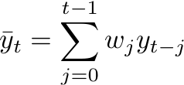

Exponential Smoothing 2 of 2
Algorithm:
Initialize at t=1:
Update:
Forecast:
Result: One-sided moving average with exponentially declining weights.
where

Slide 17
Holt-Winters Smoothing 1 of 2
If in addition to c₀ slowly evolving, the series has a trend with a slowly evolving local slope, y_{t} = c_{0,t} + c_{1,t}TIME_{t} +ε_{t} where,
c_{0,t} = c_{0,t-1} +η_{t} and c_{1,t} = c_{1,t-1} + v_{t} then,
Optimal Smoothing Algorithm = Holt-Winters Smoothing.
When the data-generating process is close to the one for which Holt-Winters is optimal, the forecasts may be close to optimal.

Slide 18



Holt-Winters Smoothing 2 of 2
Algorithm:
Initialize at t =2:
Update:
Forecast:
Notes:
We add another term to note the signs of the difference. That term is also updated from its previous calculations.

Slide 19





Holt-Winters Smoothing 2 of 2
Algorithm (Including Seasonality):
Initialize at t =s:
Update:
Forecast:
,
,

Slide 20
For Next Class
Readings about today’s class:
Chapter 13
Review Exercises / Problems:
Chapter 13: 2, 6, 7, 8, 10, 12
Readings for next class:
Chapter 14

